Slide 1

Psychopaths

Slide 2



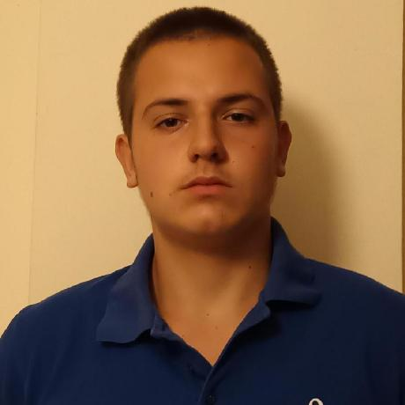

TEAM
Angel Angelov
QA Developer
Ivan Delchilov
Scrum Trainer
Gabriel Dimitrov
Frontend Developer
Stiliyan Mishev
Backend Developer

Slide 3

Idea

Slide 4

Stages
1. Discussing the idea
2. Coding
3. Debugging
4. Present the project

Slide 5








Used programs

Slide 6

Let's jump to the game

Slide 7

Thank you for your attention

